Slide 1


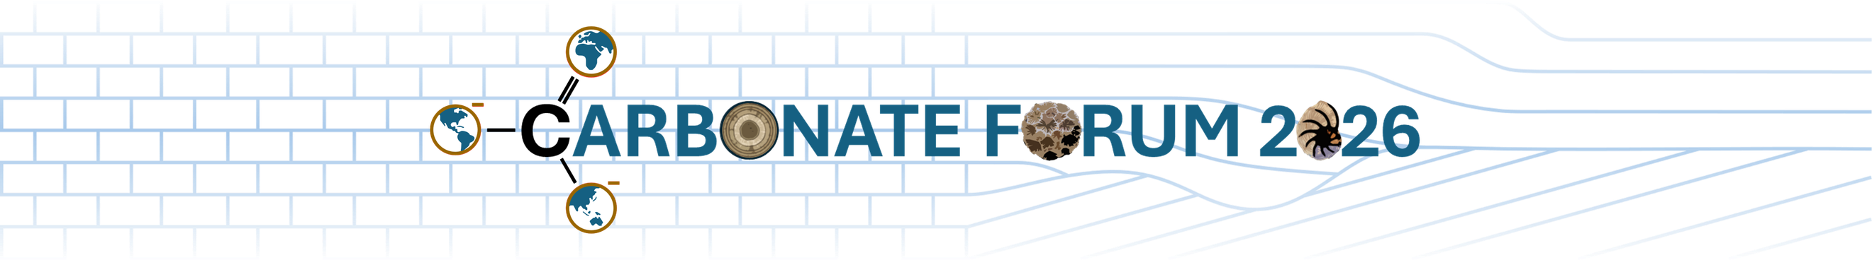
Kocaeli University
12/05/2026
HIERARCHICAL GRAIN FACIES CLASSIFICATION IN CARBONATE THIN SECTIONS USING DEEP LEARNING
PRESENTED BY:
ADVISORS:
MUSAWER MURADI
Assoc. Prof. ALEV MUTLU Faculty of Computer Engineering
Asst. Prof. ARNAUD GALLOIS Faculty of Geological Engineering

Slide 2
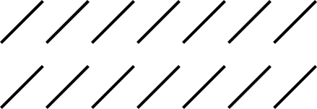
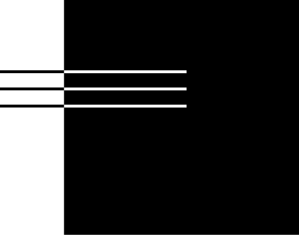
03 | Motivation
04 | Petrography
05 | Components
06 | Challenge
07 | Dataset
08 | Class Imbalance
12 | Method
15 | Evaluation
16 | Takeaways
Agenda

Slide 3
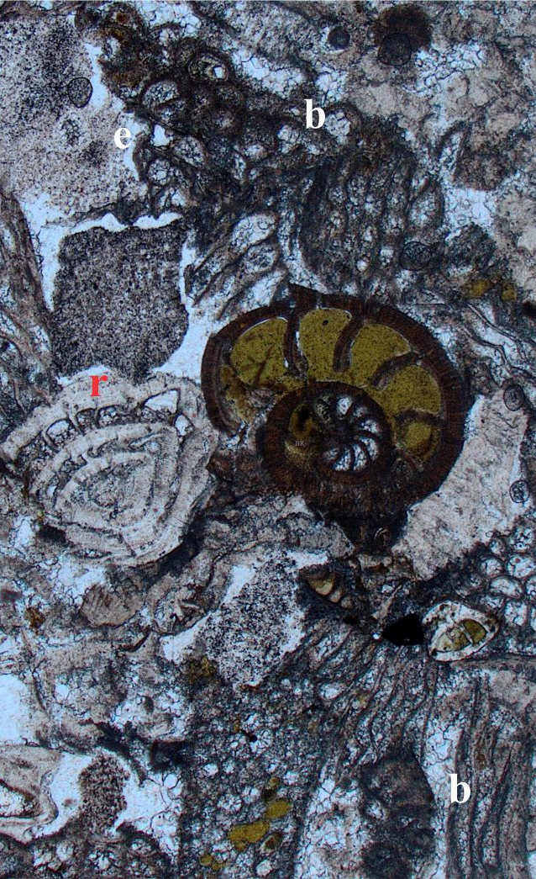
03/17
01
Grain assemblages help interpret ancient depositional environments.
Why carbonate grain classification matters
02
Rare components can carry important geological information.
Carbonate grains record depositional energy, reworking, diagenesis, and palaeoenvironmental change.
03
Broken ooids and intraclasts may indicate high-energy reworking.

Slide 4
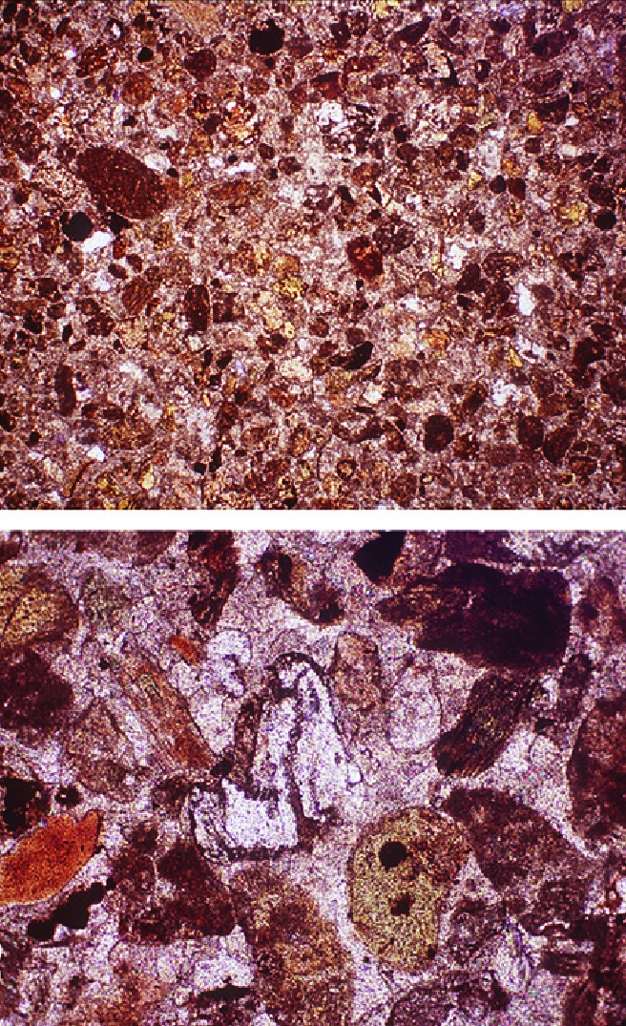
04/17
01
Standard method in sedimentary petrography
Thin-Section Petrography
02
Rock slices ground to ~30 µm thickness
Thin sections reveal carbonate grains at microscopic scale, where facies components can be identified from texture, shape, and internal fabric.
03
Observed under plain polarised light
04
Reveals grain boundaries, textures, and diagenetic alteration

Slide 5
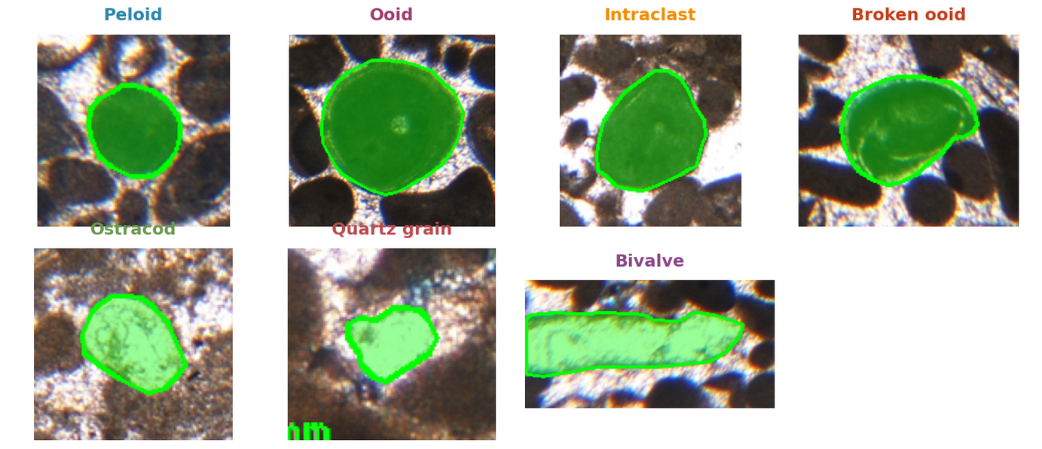
05/17
Carbonate grain facies components
THIS STUDY FOCUSES ON FOUR CARBONATE GRAIN TYPES THAT ARE COMMON OR SEDIMENTOLOGICALLY MEANINGFUL IN THE DATASET.
PELOID
OOID
BROKEN OOID
INTRACLAST
Note: Ostracods, bivalve fragments, and quartz grains were present but excluded because their sample counts were too small for reliable modelling.
Typical size context: peloids ~100 µm-1 mm; ooids ~200 µm-2 mm; intraclasts ≥200 µm; broken ooids are fractured ooids.

Slide 6
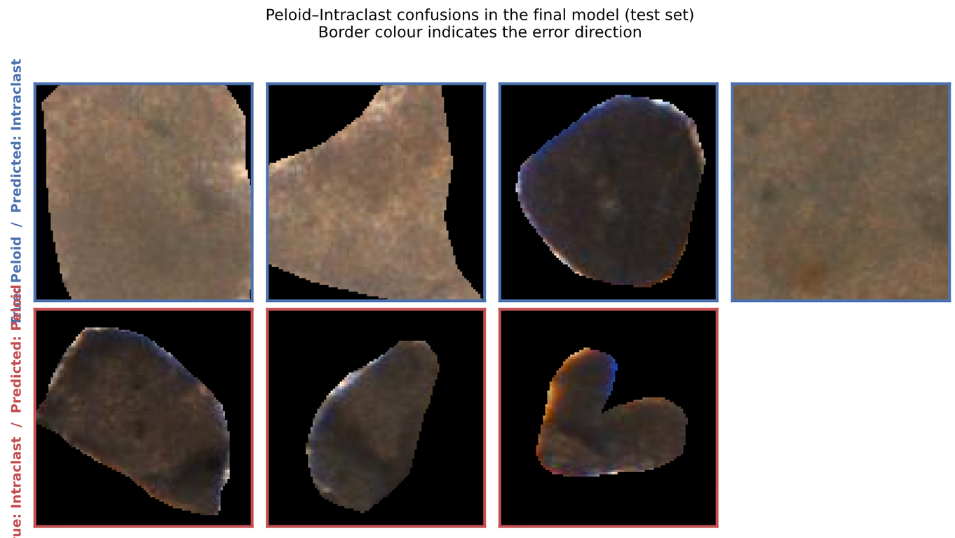
06/17
Why This Is a Hard, Manual Problem
Requires expert petrographic knowledge.
Diagenesis can erase diagnostic textures.
Peloids, altered ooids, and intraclasts may look similar.
Interpretation can become subjective in ambiguous grains.
Representative model inputs: 96 × 96 px grain patches; physical scale not calibrated.

Slide 7
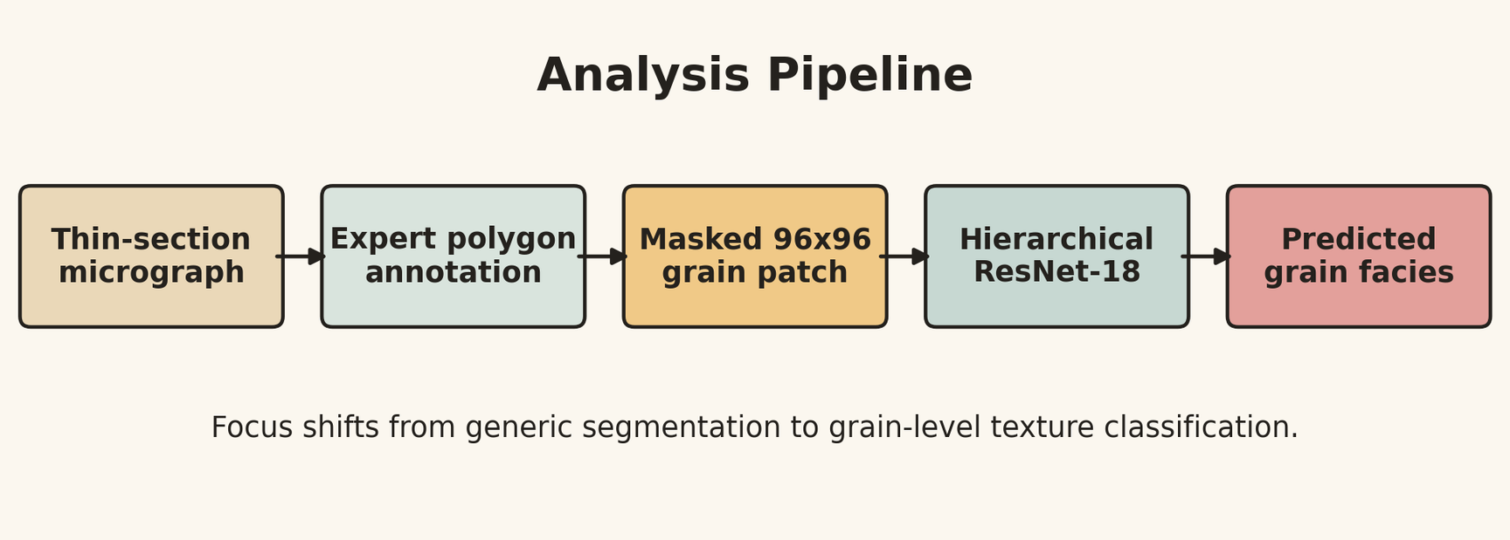
Dataset
07/17
The dataset contains 2,642 annotated carbonate grains from 18 plain polarised light micrographs.
9 thin sections
96 × 96 masked grain patches
Manual polygon annotations
Four target classes

Slide 8
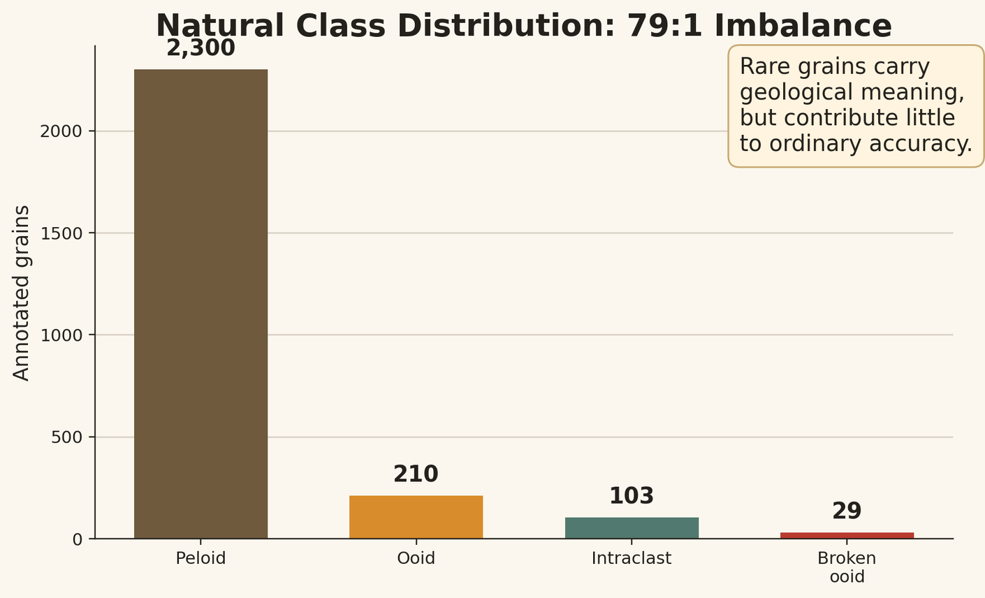
08/17
Extreme class imbalance
THE DATASET IS STRONGLY DOMINATED BY PELOIDS.
- Peloid: 2,300 grains
- Ooid: 210 grains
- Intraclast: 103 grains
- Broken ooid: 29 grains
A model can achieve high overall accuracy while still missing the rare classes.

Slide 9
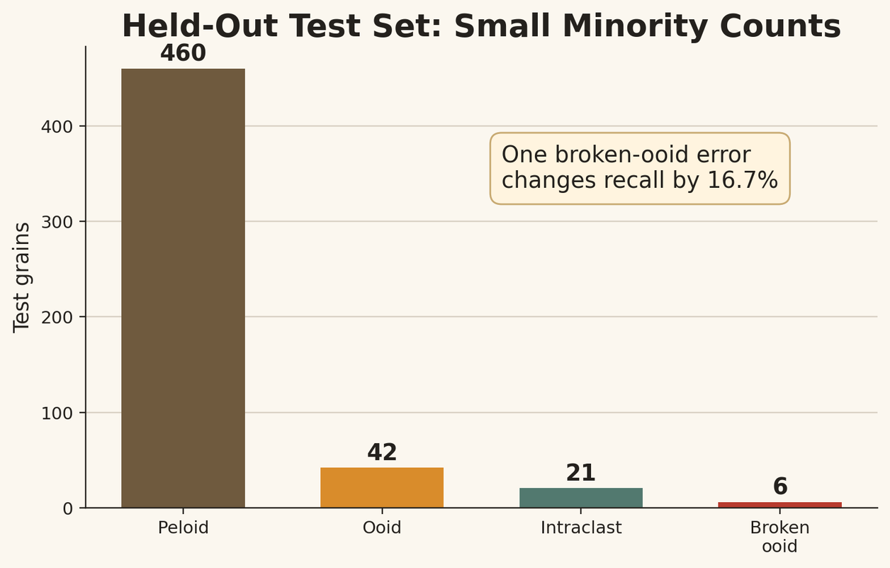
09/17
Why Balanced Accuracy matters
OVERALL ACCURACY IS MISLEADING UNDER SEVERE CLASS IMBALANCE.
- Peloids represent 87.1% of labelled grains.
- Broken ooids represent only 1.1%.
- Peloid-to-broken-ooid ratio is about 79:1.
- Balanced Accuracy gives equal importance to each class.

Slide 10
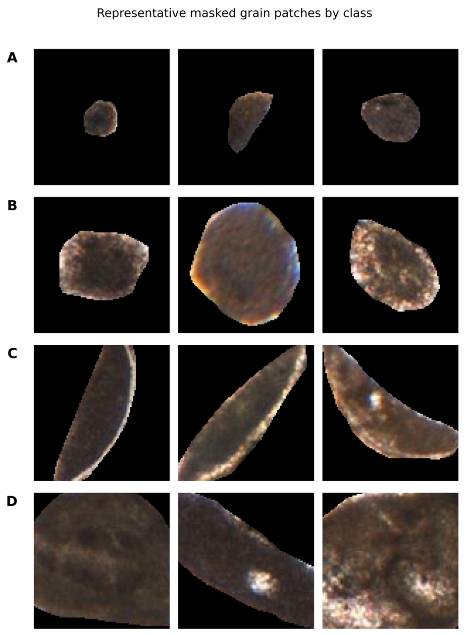
10/17
The classes are visually close
- Peloids are often micritic and structureless.
- Ooids depend on visible cortical lamination.
- Broken ooids depend on a fractured cortex.
- Intraclasts may be recognised by angularity or remnant fabric.
These are subtle petrographic distinctions, not visually obvious object categories.
Representative 96 × 96 px model inputs; physical scale varies by source micrograph and is not shown.

Slide 11
11/17
Why general computer vision is not enough
- Generic classifiers assume many examples and separable classes.
- Carbonate grains violate both assumptions.
- SAM + XGBoost was useful as a pilot.
- But generic segmentation and hand-crafted features were not enough.
- The model should follow geological reasoning.

Slide 12
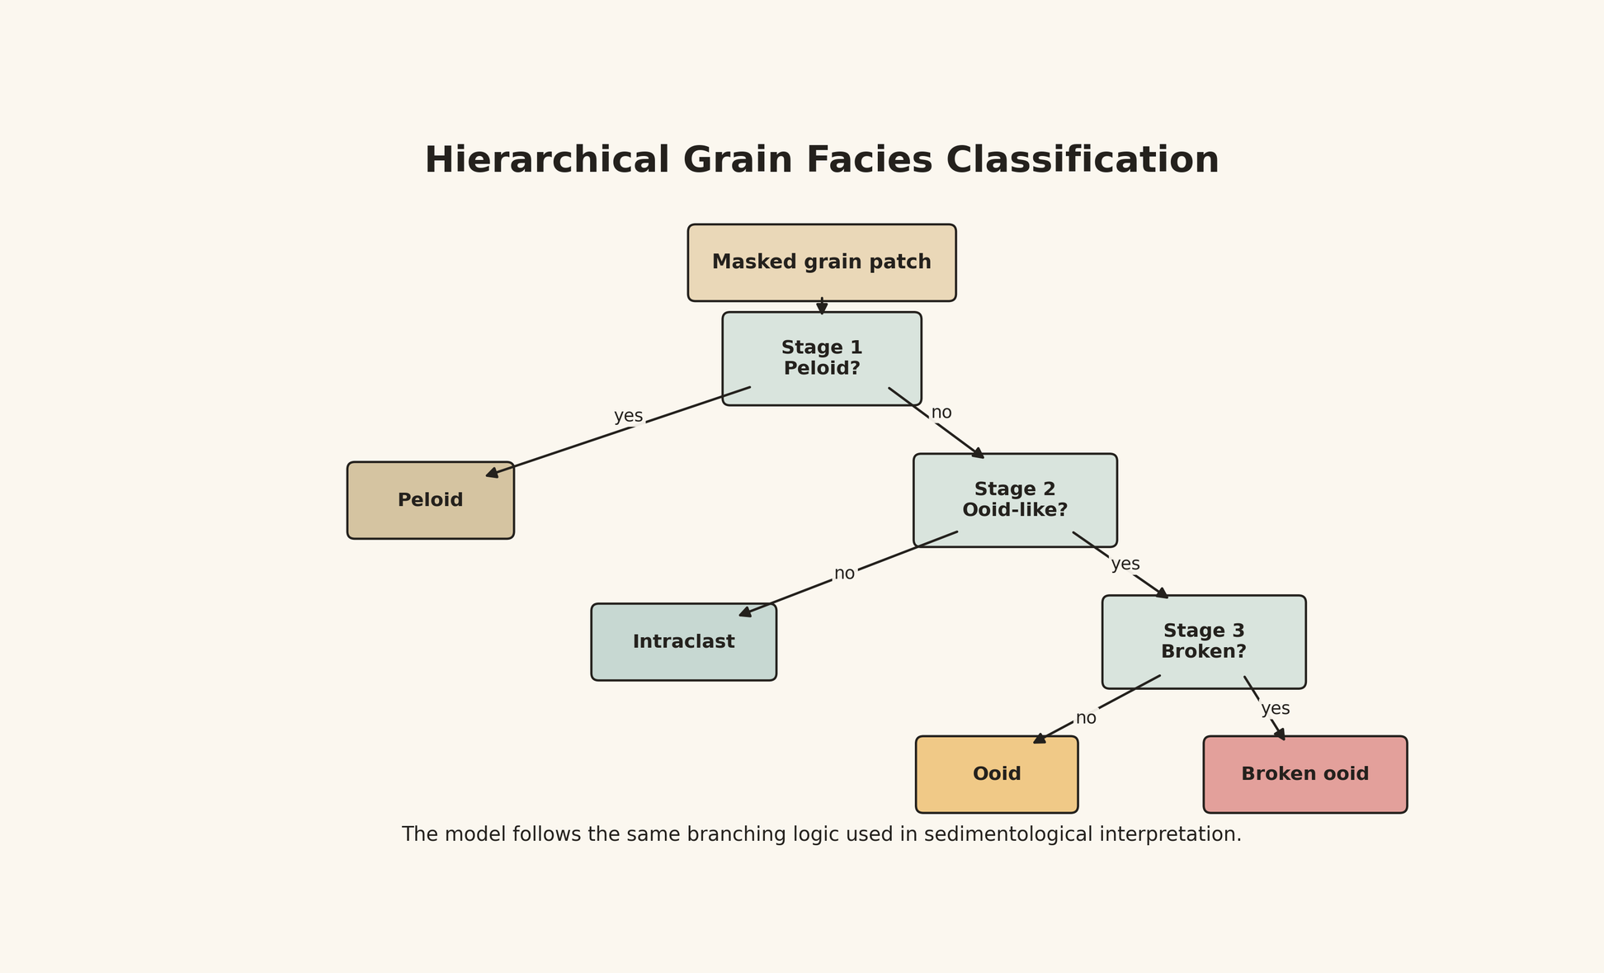
12/17
A hierarchy that follows sedimentological reasoning
Instead of one flat four-class decision, the model asks three geological questions:
1. Is this grain a peloid?
2. If not, is it ooid-like or an intraclast?
3. If ooid-like, is it intact or broken?

Slide 13
13/17
Hierarchical ResNet-18 and training strategy
- ResNet-18 extracts features from masked grain patches.
- Three binary heads implement the hierarchy.
- Focal Loss handles local imbalance.
- Broken ooids are oversampled.
- Staged training protects minority-class learning.
- Orientation averaging stabilises predictions.

Slide 14
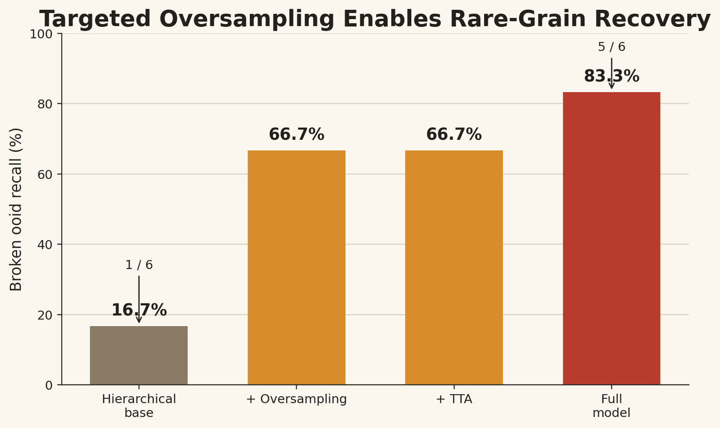
14/17
What improved rare-grain recovery?
- Hierarchical base model recovered only 1/6 broken ooids.
- With targeted oversampling: 4/6 broken ooids.
- Full model: 5/6 broken ooids.
- Balanced Accuracy improved from 63.3% to 83.5%.

Slide 15
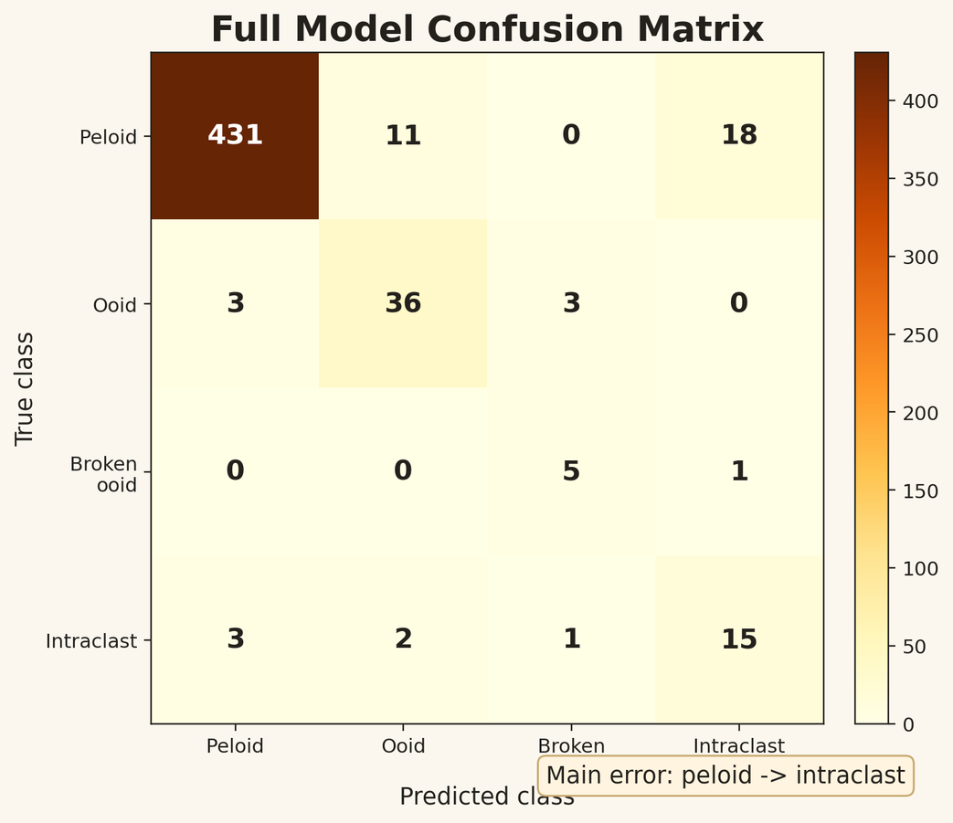
15/17
Full model performance and remaining errors
On the held-out test set of 529 grains:
- Balanced Accuracy: 83.5%
- Overall Accuracy: 92.1%
- Broken ooid recall: 83.3%
- Intraclast recall: 71.4%

Slide 16
16/17
Limitations and take-home message
Limitations:
- One carbonate succession
- Only 29 broken ooids
- Generalisation remains untested
Take-home message
- Rare grains are important but underrepresented.
- Geological hierarchy helps structure the model.
- Imbalance-aware training is essential.

Slide 17
Thank you!

